Slide 1

Fitting Linear Models, Regularization (revisited) & Cross Validation
?
Slides by:
Joseph E. Gonzalez jegonzal@cs.berkeley.edu

Slide 2
Previously

Slide 3
Feature Engineering and Linear Regression
Domain
Feature Engineering
Linear
Regression

Slide 4

Recap: Feature Engineering
Notation: Computer scientist / ML researchers tend to you d (dimensions) and statisticians will use p (parameters).
Linear models with feature functions:
Feature Functions:
p
Domain

Slide 5
One-hot encoding: Categorical Data
Bag-of-words & N-gram: Text Data
Custom Features: Domain Knowledge

Slide 6
The Feature Matrix
Domain
DataFrame
uid | age | state | hasBought | review
0 | 32 | NY | True | ”Meh.”
42 | 50 | WA | True | ”Worked out of the box …”
57 | 16 | CA | NULL | “Hella tots lit...”
AK | … | NY | … | WY | age | hasBought | hasBought missing
0 | … | 1 | … | 0 | 32 | 1 | 0
0 | … | 0 | … | 0 | 50 | 1 | 0
0 | … | 0 | … | 0 | 16 | 0 | 1
Entirely Quantitative Values

Slide 7
The Feature Matrix
Domain
DataFrame
uid | age | state | hasBought | review
0 | 32 | NY | True | ”Meh.”
42 | 50 | WA | True | ”Worked out of the box …”
57 | 16 | CA | NULL | “Hella tots lit...”
AK | … | NY | … | WY | age | hasBought | hasBought missing
0 | … | 1 | … | 0 | 32 | 1 | 0
0 | … | 0 | … | 0 | 50 | 1 | 0
0 | … | 0 | … | 0 | 16 | 0 | 1
Entirely Quantitative Values
Another quick note on confusing notation.
In many textbooks and even in the class notes and discussion you will see:
and
In this case we are assuming X is the transformed data 𝚽. This can be easier to read but hides the feature transformation process.
Capital Letter: Matrix or Random Variable?
Both tend to be capitalized
Unfortunately, there is no common convention … you will have to use context.

Slide 8
The Feature Matrix
AK | … | NY | … | WY | age | hasBought | hasBought missing
0 | … | 1 | … | 0 | 32 | 1 | 0
0 | … | 0 | … | 0 | 50 | 1 | 0
0 | … | 0 | … | 0 | 16 | 0 | 1
Domain
Entirely Quantitative Values
n
Rows of the 𝚽 matrix correspond to records.
=
=
DataFrame
Columns of the 𝚽 matrix correspond to features.
d
Confusing notation!
uid | age | state | hasBought | review
0 | 32 | NY | True | ”Meh.”
42 | 50 | WA | True | ”Worked out of the box …”
57 | 16 | CA | NULL | “Hella tots lit...”

Slide 9
The Feature Matrix
AK | … | NY | … | WY | age | hasBought | hasBought missing
0 | … | 1 | … | 0 | 32 | 1 | 0
0 | … | 0 | … | 0 | 50 | 1 | 0
0 | … | 0 | … | 0 | 16 | 0 | 1
Domain
Entirely Quantitative Values
n
Rows of the 𝚽 matrix correspond to records.
=
=
DataFrame
Columns of the 𝚽 matrix correspond to features.
Notation Guide
d
: row i of matrix A.
: column j of matrix A.
uid | age | state | hasBought | review
0 | 32 | NY | True | ”Meh.”
42 | 50 | WA | True | ”Worked out of the box …”
57 | 16 | CA | NULL | “Hella tots lit...”

Slide 10
Making Predictions
AK | … | NY | … | WY | age | hasBought | hasBought missing
0 | … | 1 | … | 0 | 32 | 1 | 0
0 | … | 0 | … | 0 | 50 | 1 | 0
0 | … | 0 | … | 0 | 16 | 0 | 1
Entirely Quantitative Values
n
Domain
Rows of the 𝚽 matrix correspond to records.
=
=
DataFrame
Columns of the 𝚽 matrix correspond to features.
d
Prediction
n
=
=
d
uid | age | state | hasBought | review
0 | 32 | NY | True | ”Meh.”
42 | 50 | WA | True | ”Worked out of the box …”
57 | 16 | CA | NULL | “Hella tots lit...”

Slide 11
Normal Equations
Solution to the least squares model:
Given by the normal equation:
You should know this!
You do not need to know the calculus based derivation.
You should know the geometric derivation …

Slide 12
Geometric Derivation: Not Bonus Material
We decided you that this is too exciting to not know.
Examine the column spaces:
Columns space of 𝚽
n
n
=
d
1

Slide 13
Geometric Derivation: Not Bonus Material
We decided you that this is too exciting to not know.
Examine the column spaces:
n dimensional space
Y
Columns space of 𝚽
n
n
=
d dimensional subspace
d
1
Derivation
Definition of orthogonality
“Normal Equation”

Slide 14
The Normal Equation
n
d
n
1
-1
d
=
d
Note: For inverse to exist 𝚽 needs to be full column rank.
→ cannot have co-linear features
This can be addressed by adding regularization …
In practice we will use regression software (e.g., scikit-learn) to estimate θ

Slide 15
Least Squares Regression in Practice
Use optimized software packages
Address numerical issues with matrix inversion
Incorporate some form of regularization
Address issues of collinearity
Produce more robust models
We will be using scikit-learn:
http://scikit-learn.org/stable/modules/linear_model.html
See Homework 6 for details!

Slide 16
Scikit Learn Models
Scikit Learn has a wide range of models
Many of the models follow a common pattern:
from sklearn import linear_model
f = linear_model.LinearRegression(fit_intercept=True)
f.fit(train_data[['X']], train_data['Y'])
Yhat = f.predict(test_data[['X']])
Ordinary Least Squares Regression

Slide 17
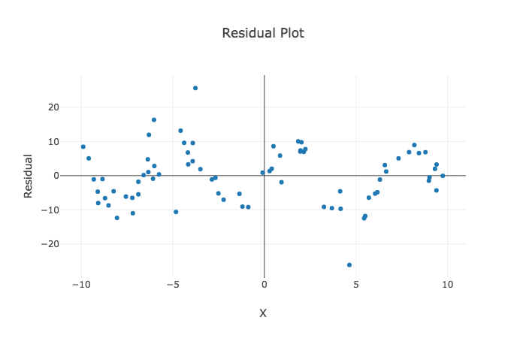
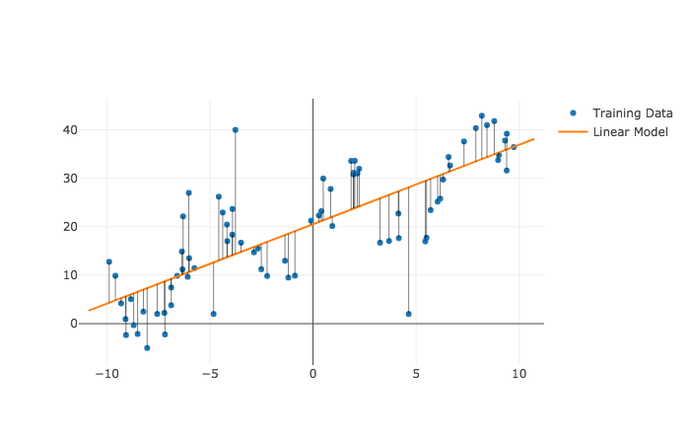
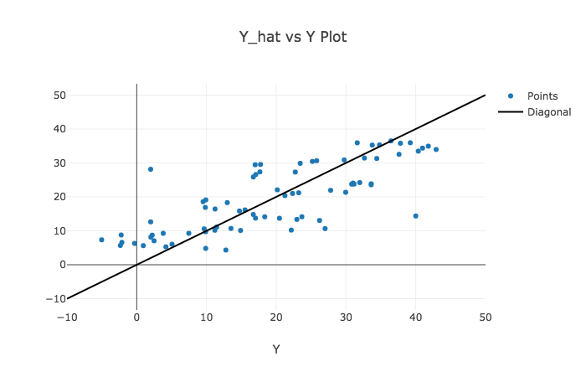
Diagnosing Fit → The Residuals
Dependence on each feature
Residuals
Predicted Y vs True Y
Look at Spread

Slide 18
Notebook Demo

Slide 19
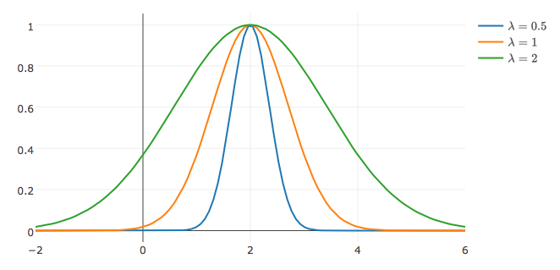
Generic Features: increase model expressivity
Gaussian Radial Basis Functions:
Gaussian RBF

Slide 20
Training Error
Impressive!

Slide 21
Training vs Test Error
Failure to Generalize!
Impressively
Bad! ☹

Slide 22
Training vs Test Error
Training error typically under estimates test error.
← Underfitting
Overfitting →
Best Fit
Test Error
Error
Training Error
Model “complexity”
(e.g., number of features)

Slide 23
Generalization: The Train-Test Split
Training Data: used to fit model
Test Data: check generalization error
How to split?
Randomly, Temporally, Geo…
Depends on application (usually randomly)
What size? (90%-10%)
Larger training set → more complex models
Larger test set → better estimate of generalization error
Typically between 75%-25% and 90%-10%
Train - Test
Split
Train
Data
Test
You can only use the test dataset once after deciding on the model.

Slide 24
Generalization: Validation Split
Training Data: used to fit model
Test Data: check generalization error
How to split?
Randomly, Temporally, Geo…
Depends on application (usually randomly)
What size? (90%-10%)
Larger training set → more complex models
Larger test set → better estimate of generalization error
Typically between 75%-25% and 90%-10%
V
Train - Test
Split
Validation
Split
Train
Train
V
Train
Train
V
Train
Data
V
Train
Validate Generalization
V
5-Fold
Cross Validation
Test
Cross validation simulates multiple train test-splits on the training data.
You can only use the test dataset once after deciding on the model.

Slide 25
Recipe for Successful Generalization
Split your data into training and test sets (90%, 10%)
Use only the training data when designing, training, and tuning the model
Use cross validation to test generalization during this phase
Do not look at the test data
Commit to your final model and train once more using only the training data.
Test the final model using the test data. If accuracy is not acceptable return to (2). (Get more test data if possible.)
Train on all available data and ship it!

Slide 26
Returning to Regularization

Slide 27
Regularization Parametrically Controlling the Model Complexity
𝜆

Slide 28
Basic Idea
Such that:
is not too “complicated”
Can we make this more formal?

Slide 29
Basic Idea
Regularization Parameter
Such that:
Complexity( )
How do we define this?

Slide 30
Idealized Notion of Complexity
Complexity( )
Focus on complexity of linear models:
Number and kinds of features
Ideal definition:
Why?
Number of non-zero parameters

Slide 31
Ideal “Regularization”
Find the best value of θ which uses fewer than β features.
Such that:
Need an approximation!
Combinatorial search problem
→ NP-hard to solve in general.

Slide 32
Norm Balls
L⁰ Norm Ball

Slide 33
Norm Balls
Non-convex → Hard to solve constrained optimization problem
L⁰ Norm Ball

Slide 34
Norm Balls
L⁰ Norm Ball
Can we construct a convex approximation?

Slide 35
Norm Balls
Convex approximation!
L¹ Norm Ball

Slide 36
Norm Balls
Convex approximation!
L¹ Norm Ball

Slide 37
Norm Balls
Convex approximation!
L¹ Norm Ball

Slide 38
Norm Balls
Convex approximation!
L¹ Norm Ball

Slide 39
Norm Balls
Other Approximations?
L¹ Norm Ball

Slide 40
Norm Balls
L² Norm Ball

Slide 41
Norm Balls
L² Norm Ball

Slide 42
Norm Balls
L² Norm Ball

Slide 43
Norm Balls
L² Norm Ball

Slide 44
L⁰ Norm Ball
L¹ Norm Ball
L² Norm Ball
L¹ + L² Norm
^{Elastic Net}
Ideal for Feature Selection but combinatorically difficult to optimize
Encourages Sparse Solutions
Convex!
Spreads weight over features (robust)
does not encourage sparsity
Compromise
Need to tune two regularization parameters

Slide 45
Generic Regularization (Constrained)
Defining
There is an equivalent unconstrained formulation (obtained by Lagrangian duality)
Such that:

Slide 46
Generic Regularization (Constrained)
Defining
There is an equivalent unconstrained formulation (obtained by Lagrangian duality)
Regularization Parameter

Slide 47
Determining the Optimal 𝜆
Test Error
Optimal Value
Validation Error
(Bias)²
Error
How do we determine 𝜆?
Variance
Increasing 𝜆
Value of 𝜆 determines bias-variance tradeoff
Larger values → more regularization → more bias → less variance
Determined through cross validation

Slide 48
Using Scikit-Learn for Regularized Regression
import sklearn.linear_model
Regularization parameter 𝛼 = 1/λ
larger 𝛼 ➔ less regularization → greater complexity → overfitting
Lasso Regression (L1)
linear_model.Lasso(alpha=3.0)
linear_model.LassoCV() automatically picks 𝛼 by cross-validation
Ridge Regression (L2)
linear_model.Ridge(alpha=3.0)
linear_model.RidgeCV() automatically selects 𝛼 by cross-validation
Elastic Net (L1 + L2)
linear_model.ElasticNet(alpha=3.0, l1_ratio = 2.0)
linear_model.ElasticNetCV() automatically picks 𝛼 by cross-validation

Slide 49
Standardization and the Intercept Term
Height = θ₁ age_in_seconds + θ₂ weight_in_tons
Regularization penalized dimensions equally
Standardization
Ensure that each dimensions has the same scale
centered around zero
Intercept Terms
Typically don’t regularize intercept term
Center y values (e.g., subtract mean)
Small
Large
Standardization
For each dimension k:

Slide 50
Regularization and High-Dimensional Data
Regularization is often used with high-dimensional data
d
d
𝚽
Tall Skinny Matrix
𝚽
High-dimensional sparse matrix
n
n >> d
typically dense
Regularization can help with complex feature transformations
n
d > n
requires regularization
Goal: to determine informative dimensions
Consider L1 Regularization. Why?
Goal: is to make robust predictions
Consider L2 (+L1) Regularization

Slide 51
Matching!
n
n
n
(A)
http://bit.ly/ds100-sp18-mat
d
1
n
(C)
(D)
(E)
d
1)
2)
3)
4)
(B)
d
d
d
Residuals
Zero Vector
1
1
n
1

Slide 52
Classification

Slide 53
Recap: Least Squares Regression
Domain
f
Feature Engineering
Squared Loss
Regularization

Slide 54
Classification
Domain
f
isAlive?
{0,1}
Can we just use least squares?

Slide 55
Python Demo

Slide 56
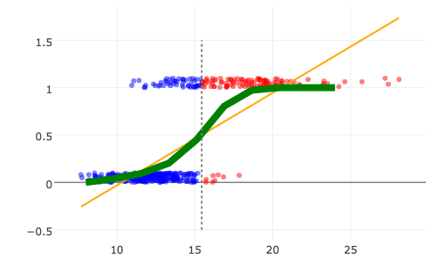
Classification
Domain
f
isCat?
{0,1}
Can we just use least squares?

Slide 57

Classification
Domain
f
isCat?
{0,1}
Can we just use least squares?
Yes … (can be easy to compute)
Need a decision function (e.g., f(x) > 0.5) …
Difficult to interpret model …
Don’t use Least Squares for Classification
Eh…

Slide 58
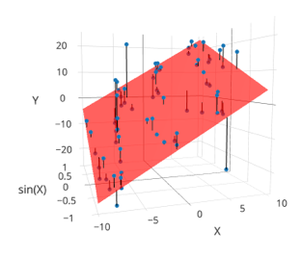
Taxonomy of Machine Learning
Labeled Data
Unlabeled Data
Supervised Learning
Reinforcement
Learning
(not covered)
Unsupervised
Learning
Quantitative Response
Categorical Response
Dimensionality Reduction
Clustering
Regression
Classification
Alpha Go

Slide 59
Kinds of Classification
Binary classification: Two classes
Examples: Spam/Not Spam, churn/stay
Multiclass classification: Many classes (>2)
Examples: Image labeling (Cat, Dog, Car), Next word in a sentence …
Structured prediction tasks (Classification)
Multiple related predictions
Examples: Translation, Voice recognition

Slide 60
Defining the Model

Slide 61
Logistic Regression
Widely used models for binary classification:
Models the probability of y=1 given x
“Get a FREE sample ...”
1 = ”Spam”
0 = “Ham”
Why is ham good and spam bad? … (https://www.youtube.com/watch?v=anwy2MPT5RE )

Slide 62
Logistic Regression
Widely used models for binary classification:
Models the probability of y=1 given x
“Get a FREE sample ...”
1 = ”Spam”
0 = “Ham”
Why is ham good and spam bad? … (https://www.youtube.com/watch?v=anwy2MPT5RE )

Slide 63
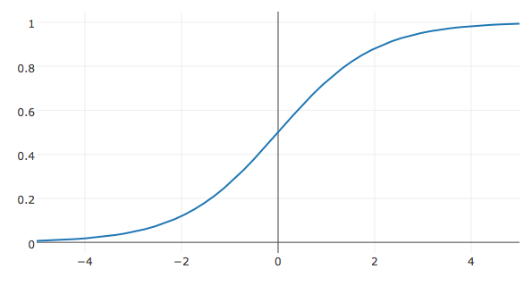
Logistic Regression
Model:

Slide 64
Python Demo

Slide 65
The Logistic Regression Model
Model:
How do we fit the model to the data?

Slide 66
Defining the Loss

Slide 67
The Logistic Regression Model
Model:
The data:
“Get a FREE sample ...”
Corresponding probability:
= 1
= 0

Slide 68
Loss Function
We want our model to be close to the data:
Kullback–Leibler (KL) Divergence
For a single (x,y) data point
Average KL Divergence for all the data:
=2
Binary Classification

Slide 69
Loss Function
We want our model to be close to the data:
Kullback–Leibler (KL) Divergence
For a single (x,y) data point
Average KL Divergence for all the data:
=2
Binary Classification
Log(a/b) = Log(a) – Log(b)
Doesn’t depend on θ

Slide 70
Loss Function
We want our model to be close to the data:
Kullback–Leibler (KL) Divergence:
For a single (x,y)
Average cross entropy loss
=2
Binary Classification

Slide 71
Loss Function
We want our model to be close to the data:
Kullback–Leibler (KL) Divergence:
For a single (x,y)
Average cross entropy loss
=2
Binary Classification

Slide 72
Loss Function
We want our model to be close to the data:
Kullback–Leibler (KL) Divergence:
For a single (x,y)
Average cross entropy loss
=2
Binary Classification
Expanding
Grouping Terms

Slide 73
Loss Function
We want our model to be close to the data:
Kullback–Leibler (KL) Divergence:
For a single (x,y)
Average KL Divergence for all the data:
=2
Binary Classification
Expanding
Grouping Terms
Alg.
Alg.
Alg.

Slide 74
Loss Function
We want our model to be close to the data:
Kullback–Leibler (KL) Divergence:
For a single (x,y)
Average KL Divergence for all the data:
=2
Binary Classification
Expanding
Grouping Terms
Defn. of σ
Alg.
Alg.
Defn. of σ
Definition

Slide 75
The Loss for Logistic Regression
Average cross entropy (simplified):
Equivalent to (derived from) minimizing the KL divergence
Also equivalent to maximizing the log-likelihood of the data … (not covered in DS100 this semester)
Is this loss function reasonable?

Slide 76
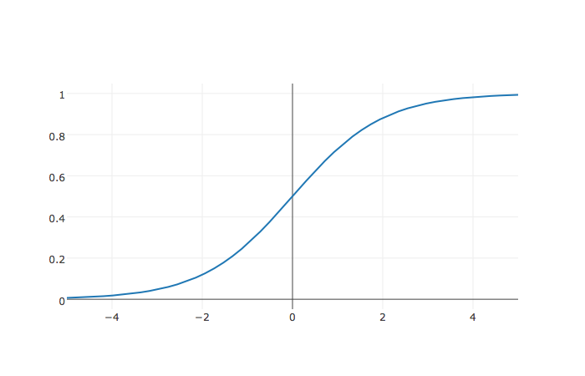
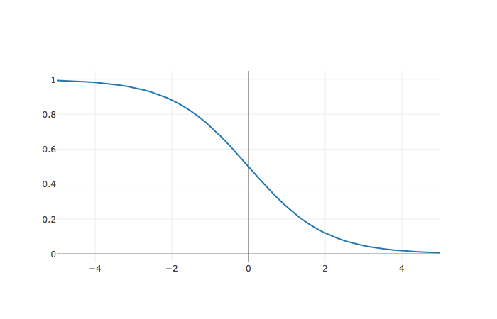
What is the value of θ?
Assume:
The Data
(-1,1)
1
(1,0)
-1
0
1

Slide 77
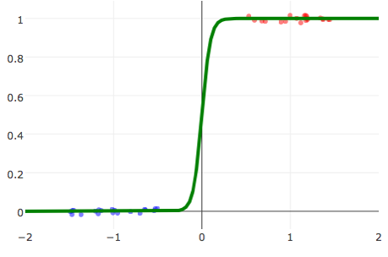
Linearly Separable Data
Linearly Separable Data
A classification dataset is said to be linearly separable if there exists a hyperplane that separates the two classes.
If data is linearly separable, logistic regression requires regularization
Not Linearly Separable Data
Weights go to infinity!

Slide 78
Logistic Loss Function
Average KL divergence (simplified)
Take Derivative:

Slide 79
Logistic Loss Function
Average KL divergence (simplified)
Take Derivative:

Slide 80
Logistic Loss Function
Average KL divergence (simplified)
Take Derivative:
Useful Identity
Chain Rule
Chain Rule
Alg.
Defn. of σ
Alg.

Slide 81
Logistic Loss Function
Average KL divergence (simplified)
Take Derivative:
Useful Identity

Slide 82
Logistic Loss Function
Average KL divergence (simplified)
Take Derivative:
Set derivative = 0 and solve for θ
No general analytic solution
Solved using numeric methods

Slide 83
The Gradient Descent Algorithm
initial vector (random, zeros …)
For 𝜏 from 0 to convergence:
Evaluated
at
ρ(𝜏) is the step size (learning rate)
typically 1/𝜏
Converges when gradient is ≈ 0 (or we run out of patience)

Slide 84
Gradient Descent for Logistic Regression
Logistic Regression
initial vector (random, zeros …)
For 𝜏 from 0 to convergence:
ρ(𝜏) is the step size (learning rate)
typically 1/𝜏
Converges when gradient is ≈ 0 (or we run out of patience)
Notes:
= -\frac{1}{n}\sum_{i=1}^n \left(y_i
-\sigma\left(\phi(x_i)^T\theta\right) \right) \phi(x_i)

Slide 85
Demo!

Slide 86
Stochastic Gradient Descent
For many learning problems the gradient is a sum:
For large n this can be costly
What if we approximated the gradient by looking at a few random points:

Slide 87
Stochastic Gradient Descent
For many learning problems the gradient is a sum:
For large n this can be costly
What if we approximated the gradient by looking at a few random points:
Batch
Size
Random sample of records
This is a reasonable estimator for the gradient
Unbiased …
Often batch size is one! (why is this helpful)
Fast to compute!
A key ingredient in the recent success of deep learning

Slide 88
Stochastic Gradient Descent
initial vector (random, zeros …)
For 𝜏 from 0 to convergence:
Decomposable
Loss
Loss can be written as a sum of the loss on each record.

Slide 89
initial vector (random, zeros …)
For 𝜏 from 0 to convergence:
Gradient Descent
Very Similar Algorithms
initial vector (random, zeros …)
Assuming Decomposable Loss Functions
For 𝜏 from 0 to convergence:
Stochastic Gradient Descent

Slide 90

Stochastic Gradient Intuition
Will I make it to the bottom?
“If I keep going downhill on average then I will get to the bottom.”
Sample -Gradient
True -Gradient
Why might this reasoning fail?

Slide 91
Python Demo!

Slide 92
Multiclass (more than 2) Classification
One-vs-rest train separate binary classifiers for each class

Slide 93
Multiclass (more than 2) Classification
One-vs-rest train separate binary classifiers for each class

Slide 94
Multiclass (more than 2) Classification
One-vs-rest train separate binary classifiers for each class

Slide 95
Multiclass (more than 2) Classification
One-vs-rest train separate binary classifiers for each class

Slide 96
Multiclass (more than 2) Classification
One-vs-rest train separate binary classifiers for each class

Slide 97
Multiclass (more than 2) Classification
One-vs-rest train separate binary classifiers for each class
Class with highest confidence wins
Need to address class imbalance issue
Soft-Max multiclass classification

Slide 98
Multiclass (more than 2) Classification
One-vs-rest train separate binary classifiers for each class
Class with highest confidence wins
Need to address class imbalance issue
Soft-Max multiclass classification
Separate for each class
Trained using gradient descent methods
Over parameterized. Why?
k sets of parameters one for each class
Only need k-1 parameters
Often use k parameters + regularization to address lack of identifiability.

Slide 99
Python Demo!

Slide 100
Deep Learning
Overview
Bonus Material
Borrowed heavily from excellent talks by:
Adam Coates: http://ai.stanford.edu/~acoates/coates_dltutorial_2013.pptx
Fei-Fei Li and Andrej Karpathy: http://cs231n.stanford.edu/syllabus.html

Slide 101

Logistic Regression as a “Neuron”
Consider the simple function family:
“perceptron”
Neuron “fires” if weighted sum of input is greater than zero.
w₂₃x₂₃
w₅₂x₅₂
w₁₂₃x₁₂₃
Bias= w₀ x

Slide 102


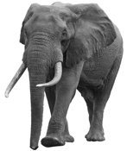

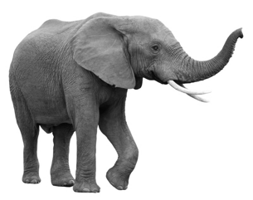
Logistic Regression: Strengths and Limitations
Widely used machine learning technique
convex → efficient to learn
easy to interpret model weights
works well given good features
Limitations:
Restricted to linear relationships → sensitive to choice of features
y = 0
y = 1
0
1
2
Pixel 2
Pixel 2
1
1
0
Pixel 1
Pixel 1

Slide 103
Feature Engineering
0
1
2
Pixel 2
Pixel 2
1
1
0
Pixel 1
Pixel 1
Rather than use raw pixels build/train feature functions:
1
=
1
(Paws, Furry)
Furry
0
0
Paws

Slide 104
Composition Linear Models and Nonlinearities
d
Input Layer
(Pixels)
W⁰
x₁
z
z
h₁
𝜎
k
=
k
k
=
k
h₂
x₂
h_{k}
1
1
1
d
x_{d}
1

Slide 105
Composition Linear Models and Nonlinearities
d
Input Layer
(Pixels)
k
W⁰
x₁
z
z
W¹
z
z
𝜎
h₁
𝜎
h₁
k
k
k
2
=
=
=
2
2
2
h₂
h₂
x₂
k
h_{k}
1
1
1
1
1
1
d
x_{d}
1

Slide 106
Neural Networks
Composing “perceptrons”
W⁰
W¹
x₁
W²
x₂
f
Input Layer
x_{d}
Hidden Layers

Slide 107
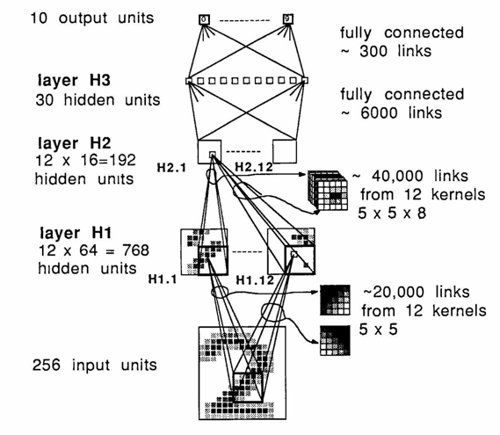
Deep Learning →Many hidden layers …
Output
Output
Input
Logistic Regression

Slide 108

Convolutional Neural Networks: Exploiting Spatial Sparsity

Slide 109
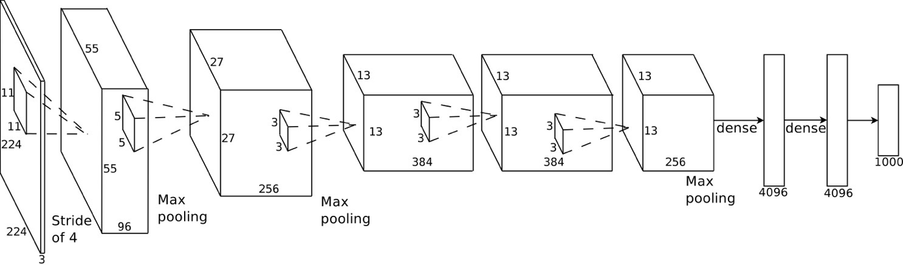
Example: AlexNet (Krizhevsky et al., NIPS 2012)
Introduced in 2012, significantly outperformed state-of-the-art (top 5 error of 16% compared to runner-up with 26% error)
Covered in reading …

Slide 110
Improvement on ImagNet Benchmark

Slide 111
Recurrent Neural Networks: Modeling Sequence Structure
El gato en el sombrero
The cat in the hat.
State of the art in speech recognition and machine translation
Required LSTM and GRU to address long dependencies
Similar to the HMM from classical Bayesian ML

Slide 112
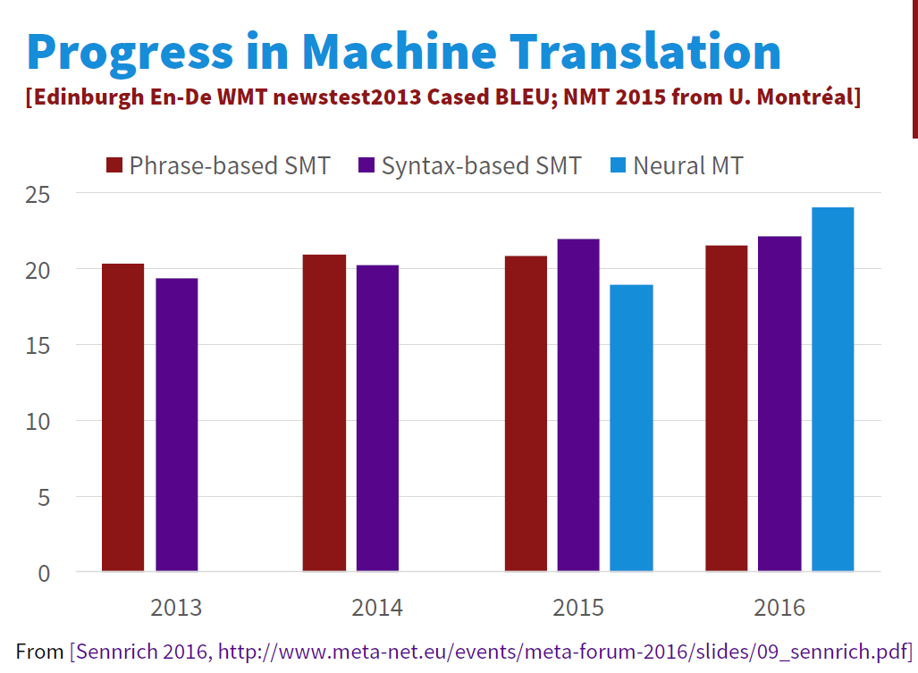
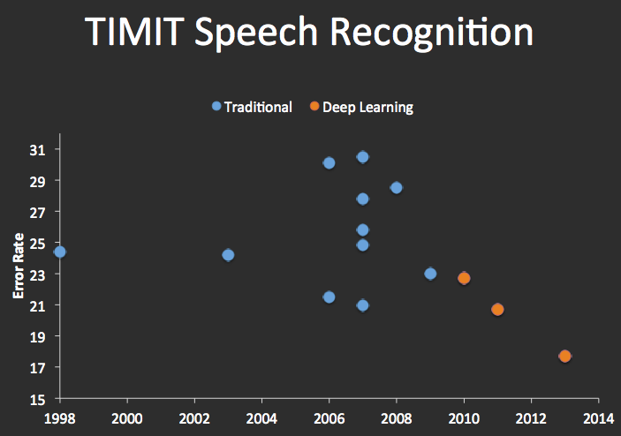
Improvements in Machine Translation & Automatic Speech Recognition

Slide 113
Interested in Deep Learning?
RISE Lab Deep Learning Overview:
https://ucbrise.github.io/cs294-rise-fa16/deep_learning.html
TensorFlow Python Tutorial
Stanford CS231 Labs
http://cs231n.github.io/linear-classify/
http://cs231n.github.io/optimization-1/
http://cs231n.github.io/optimization-2/

